Slide 1


SUBJECT CODE
TYPE THE SUBJECT NAME HERE
AUTOMATION SENSORISED ELEVATOR
DATE : 07-07-2022
BATCH NUMBER : 5
PROJECT CODE :
BATCH MEMBERS : A.Akash
P.Jaiganesh
M.Mahizhan
SUPERVISOR : Mr.K.Devibalan
SDG GOALS : 9
II
IV
20ECTE401
LIVE IN LAB 2

Slide 2

20ECTE401
220ECTE401-LIL-2
PROBLEM STATEMENT
The biggest issue we've identified in the elevator system is elevator stops that are unnecessary on certain floors where people leave after pushing the elevator buttons. We hope that our project concept can provide a solution to the issue we've identified.

Slide 3
20ECTE401
220ECTE401-LIL-2
OBJECTIVE OF THE PROJECT
The main objective of the project is to reduce the time and energy wastage while the elevator is stops at certain floors where the user is not present in that location after he/she presses the elevator button. By just skipping the floor due to the absence of the user that wastage can be remediated.

Slide 4
20ECTE401
220ECTE401-LIL-2
PROPOSED SOLUTION
The proposed solution for the problem statement is to install ir proximity sensors on the elevator's exterior. When people enter the elevator & press a button, the sensor detects them and determines the floor they are on, allowing them to proceed to that floor. If users pick the elevator button but it is not available or the button is not touched, the lift will not come towards that region.

Slide 5
20ECTE401
220ECTE401-LIL-2
REVIEW OF LITERATURE
SL NO | TITLE OF THE PAPER | TECHNOLOGY | JOURNAL NAME | YEAR
1 | Arduino rescue device for elevators | Electrolysis capacitor system | 1st international conference on current research in engineering. | 2017
2 | Laboratory model of the elevator controlled by Arduino platform | Embedded systems | MIPRO | 2017
3 | Specification of an elevator control systems | Autofocus | IEEE | 2017

Slide 6
20ECTE401
220ECTE401-LIL-2
REVIEW OF LITERATURE
SL NO | TITLE OF THE PAPER | TECHNOLOGY | JOURNAL NAME | YEAR
4 | Intelligent Control of the Lift Model | THE PROJECTION BASED SPEECH RECOGNITION ALGORITHM | 1st international conference on current research in engineering. | 2003
5 | Automation based Elevator control System | Programmable Microcontroller systems | international conference on applied and Theoretical Computing Communicating Technology | 2018
6 | Smart Elevator control system Based on human Hand Gesture Recognition | Hand Gesture Technology | IEEE | 2020

Slide 7
20ECTE401
220ECTE401-LIL-2
JUSTIFICATION FOR SDG & SAP
SDG Goal : Industry, Innovation and Infrastructure
SAP Indicator: 9 Support domestic technology development, research and innovation in developing countries, including by ensuring a conducive policy environment for, inter alia, industrial diversification and value addition to commodities.

Slide 8
20ECTE401
220ECTE401-LIL-2
BLOCK DIAGRAM OF AUTOMATED SENSORIED LIFT
PRESSURE SENSOR
CONTROL AND PROCESSING UNIT OF ELEVATOR
ARRIVAL OF ELEVATOR TO THE DESIRED FLOOR
ELEVATOR BUTTON

Slide 9
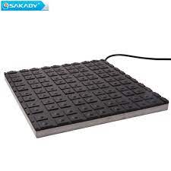
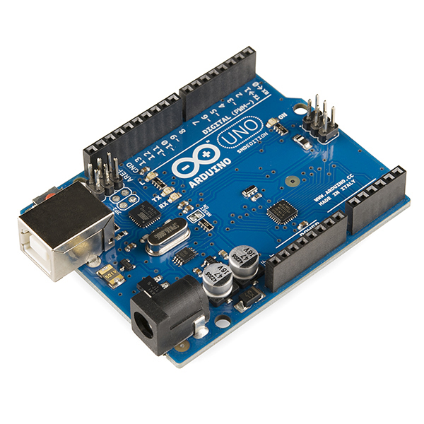
20ECTE401
EC8811
220ECTE401-LIL-2
COMPONENT OF THIS PROJECT
PRESSURE SENSOR
ARDUINO UNO

Slide 10
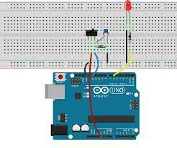
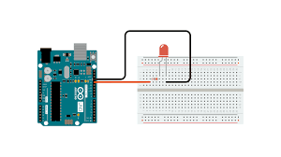
20ECTE401
EC8811
220ECTE401-LIL-2
COMPONENT OF THIS PROJECT
LED Connection to Arduino Uno
Button Connection to Arduino Uno

Slide 11
20ECTE401
220ECTE401-LIL-2
WORKING OF AUTOMATION SENSORISED ELEVATOR
From the following illustration, we'd like to create a circuit in which the sensor and button are connected to the Arduino and the led is the Arduino's output. Whenever the sensor recognizes humans as well as the button is pressed, the led illuminates. If one of these are missing, the led will not glow. This is how an automatic sensor elevator operates.

Slide 12
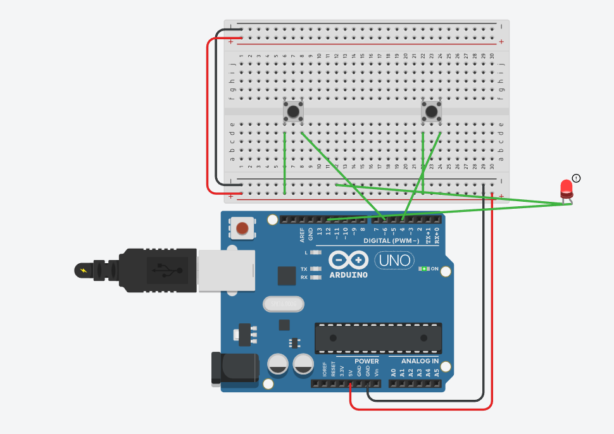
20ECTE401
220ECTE401-LIL-2
SIMULATED IMAGE

Slide 13
20ECTE401
220ECTE401-LIL-2
CONCLUSION
This goes to prove that this solution can fix the main issues with the elevator system while also saving time and energy by decreasing the elevators' needless movement between floors. As this project is directly connected to the CPU of the elevator system, it aids in our efforts to preserve electricity.

Slide 14
20ECTE401
220ECTE401-LIL-2
FUTURE SCOPE OF THE PROJECT
As the pressure sensor used in this project converts mechanical energy into electrical energy, which is used for an emergency power functional unit that is employed in elevators during power outages, we have intended to improve this project by generating electricity with its assistance.

Slide 15
E20ECTE401
C8811
220ECTE401-LIL-2
PROJECT MANAGEMENT- GANTT CHART
WORK | MAR’22 | APR’22 | MAY’22 | JUNE’22 | JULY’22
PROJECT APPROVAL
LIT REVIEW
SIMULATION
HARDWARE
THESIS
CONTEST
JOURNAL PUBLICATION

Slide 16
20ECTE401
220ECTE401-LIL-2
Reference
1) Smart Elevator Cotrol System Based on Human Hand Gesture Recognition
Shangzhi Le, Qujiang Lei*, Xiangying Wei, Jiahao Zhong, Yuhe Wang, Jimin Zhou, Weijun Wang Intelligent Robot & Equipment Center Guangzhou Institute of Advanced Technology, Chinese Academy of Sciences,2020 IEEE 6th International Conference on Computer and Communications.
2) Cai Z, Han J, Liu L, et al. RGB-D datasets using Microsoft Kinect or similar sensors: a survey[J]. Multimedia Tools and Applications, 2017, 76(3): 4313-4355.
3) Kabir R, Ahmed N, Roy N, et al. A Novel Dynamic Hand Gesture and Movement Trajectory Recognition model for Non-Touch HRI Interface[C]//2019 IEEE Eurasia Conference on IOT, Communication and Engineering (ECICE). IEEE, 2019: 505-508.
4) Liu shi-lei, The study concerning human-computer interaction used in the manual segmentation and identification of key techniques Shan Dong University,2017.
5) Laboratory Model of the Elevator Controlled by ARDUINO Platform Marijo Andrija Balug*, Tomislav Špoljarić* and Goran Vujisić** Faculty of Electrical Engineering and Computer Science, Maribor, Slovenia **University of Applied Sciences - Department of Electrical Engineering, Zagreb, Croatia, MIPRO, 2017

Slide 17
E20ECTE401
C8811
20ECTE401-LIL-2
2
THANK YOU

